Slide 1

Project
Alpha Six
Rutgers Data Science Bootcamp
Group Six
Project One

Slide 2

Champions! Top row: Diantha, Cynthia, Wallace, Leon, Gary/Blue, Alder.
Bottom row: Iris, Steven, Lance.
Project Alpha Six

Slide 3






The Elite
Les Molinares
Miggy Lacson
Mabe Martinez
Project Alpha Six

Slide 4



Pokémon Championship Material: What Team Would Lead You to Victory?
Type Distribution
What are the most common and rarest Pokémon types?
Which types hold the highest average of each stat?
How does typing come into play for the ideal Championship team?
Does the most common or least common type hold more statistical prestige?
Size and Stat Relationships
Does Pokémon size determine their stats?
What correlation exists between different stat categories vs. height and weight?
How different are the correlations between size stats and battle stats?
Championship Team
Would you choose a team where each Pokémon is the peak of one stat?
Would you choose a team based on size?
Would you choose a team with the highest stats?
Does it include your favorite Pokémon?
Project Alpha Six

Slide 5
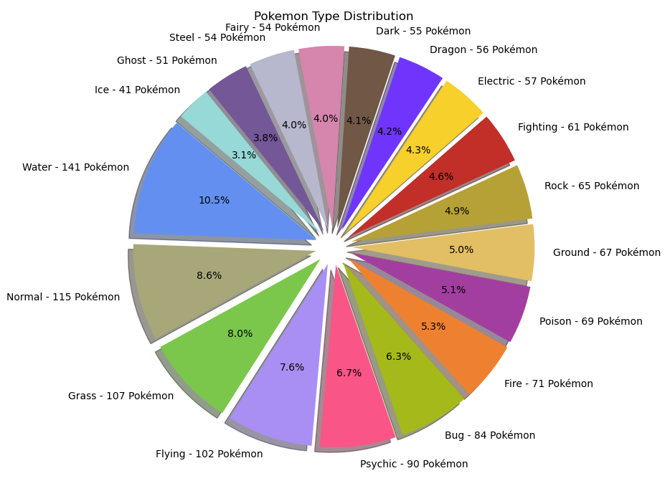
Pokémon Type Distribution
This type distribution chart considers listings where many Pokémon have two different types.
Most Common Types
Water – 141 Pokémon
Normal – 115 Pokémon
Grass – 107 Pokémon
Rarest Types
Ice – 41 Pokémon
Ghost – 51 Pokémon
Steel and Fairy – 54 Pokémon
The rarer type counts are due to a variety of reasons, chief among them being the fact that the Dark, Steel, and Fairy types were introduced later in the Pokémon franchise, with Fairy being the most recent.
Project Alpha Six

Slide 6










With the most common and least common types accounted for, we can examine which of these types come into play in terms of average individual stat counts.
Pokémon Champions typically do not base their teams on a singular type like Gym Leaders and the Elite Four do.
Project Alpha Six

Slide 7
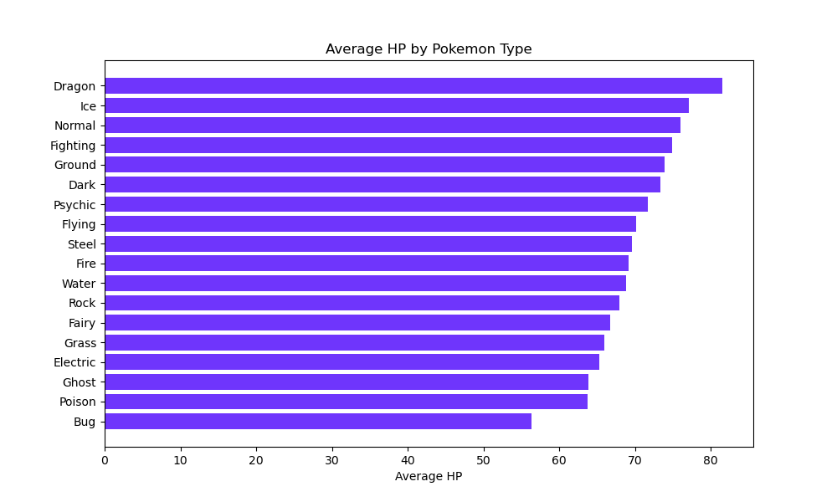
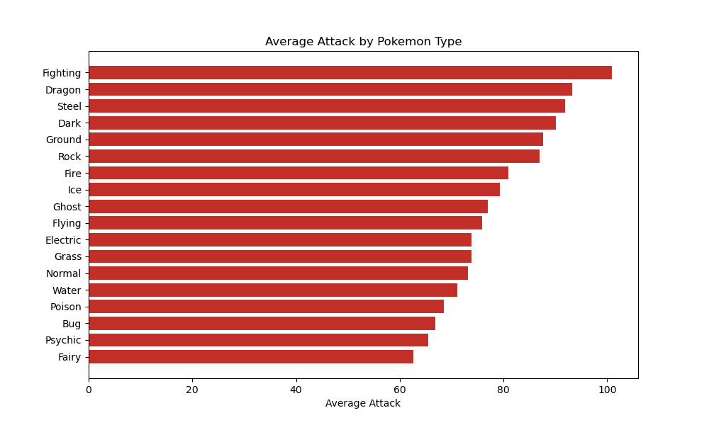
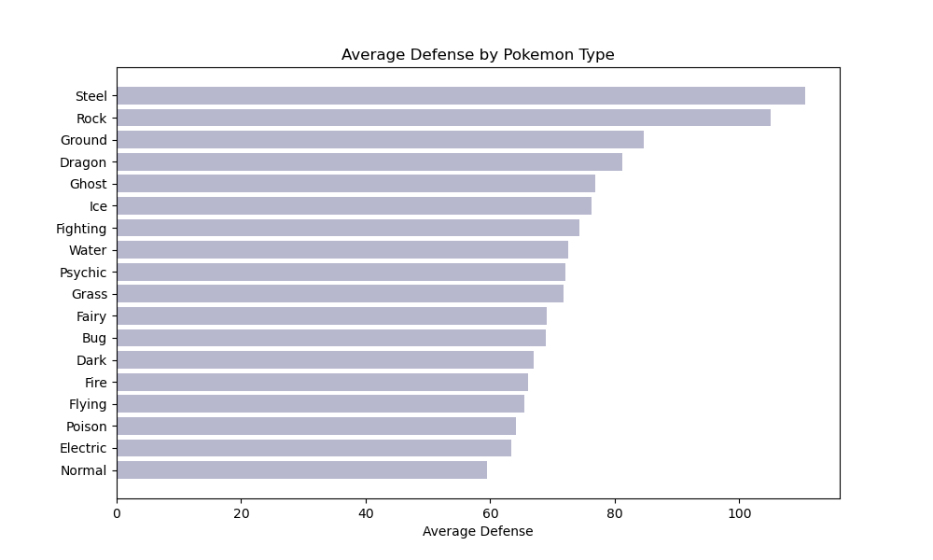


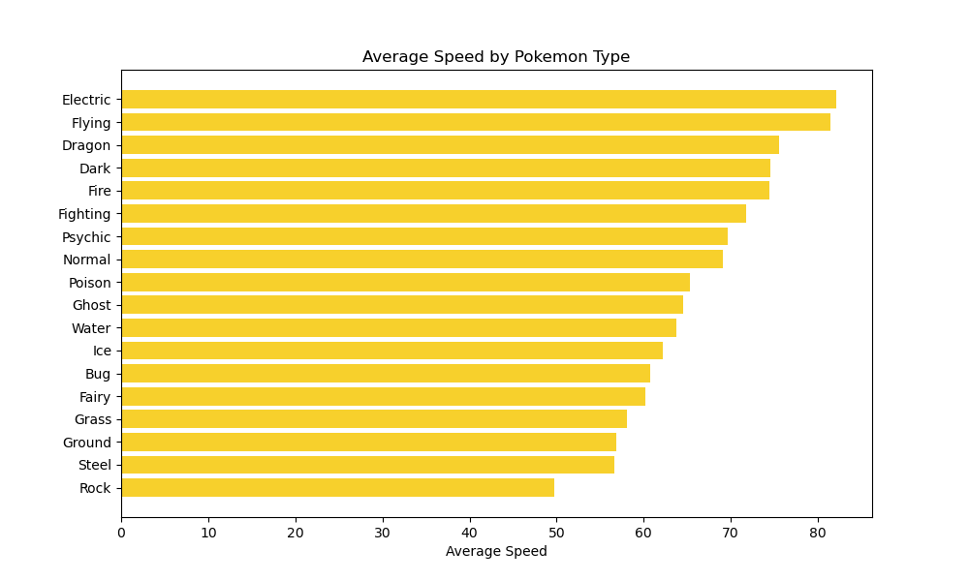
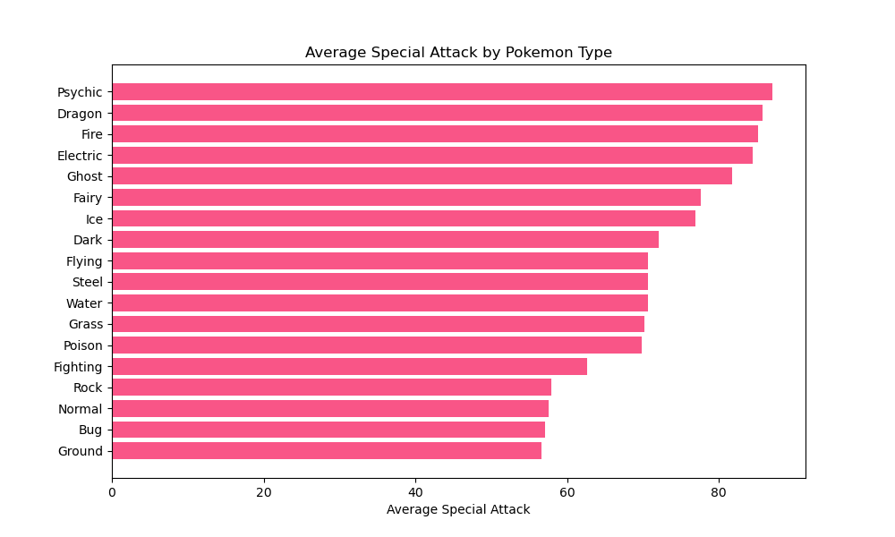
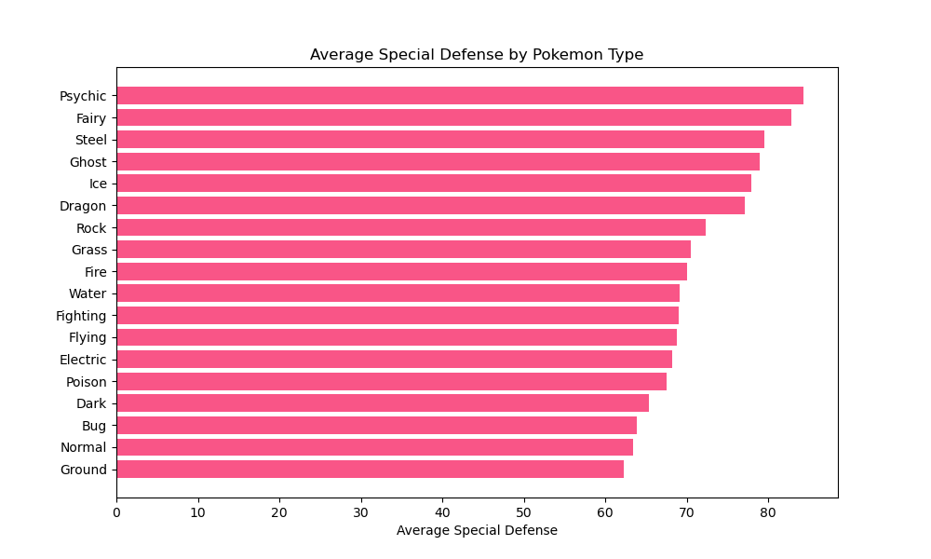

Stat Averages by Type
Project Alpha Six

Slide 8
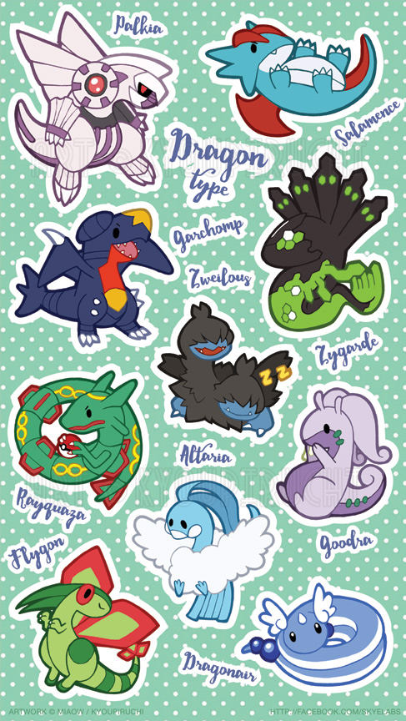


Stat Average by Type Analysis
Dragon types are amongst the top three types in all stat averages, except for Defense and Special Defense, supporting the status Dragon types hold as kings of offensive stats.
Psychic types are the only types to rank top average in two categories; Special Attack and Special Defense.
Steel types are considered the kings of defense, holding top rank in Defense and top three in Special Defense.
The bottom of the barrel? Bug types.
Bug types are within the bottom three ranks for all stats, except for Speed.
Project Alpha Six

Slide 9
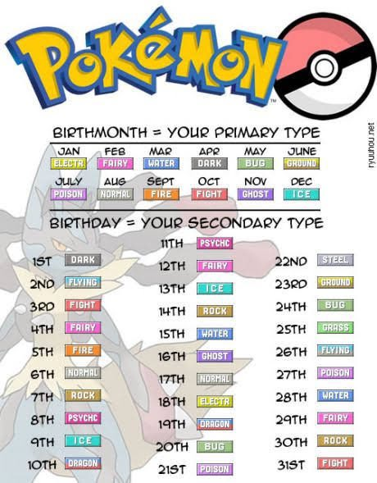




What Pokémon types would you be?
With the data explored comparing types and stat averages, we have gained insight into what can build a formidable team. Next, we aim to figure out how size may come into play with stats.
Project Alpha Six

Slide 10
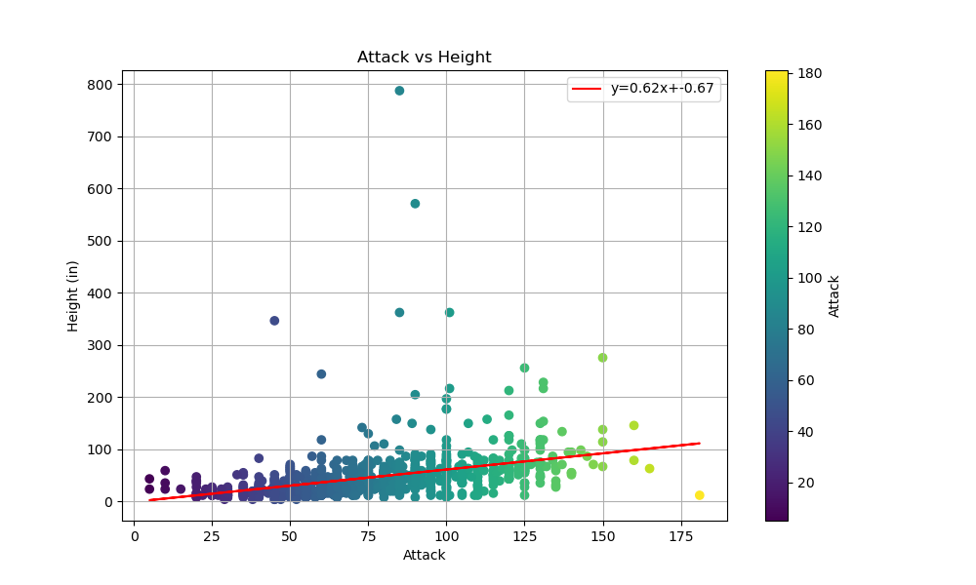
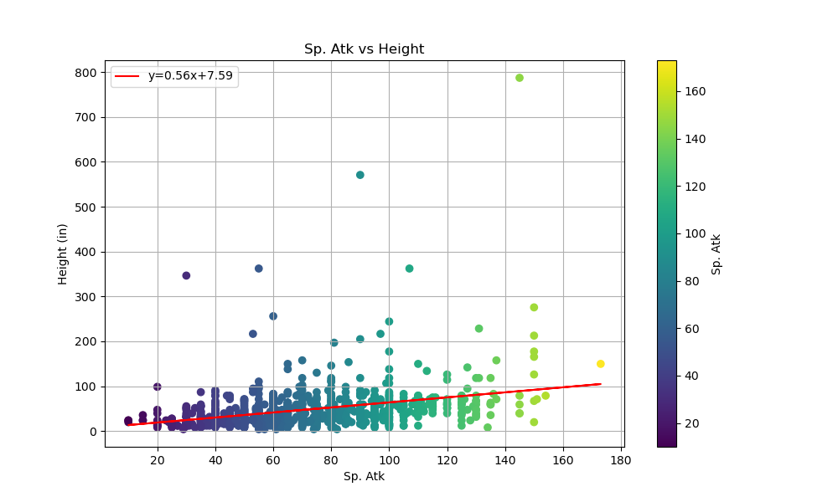
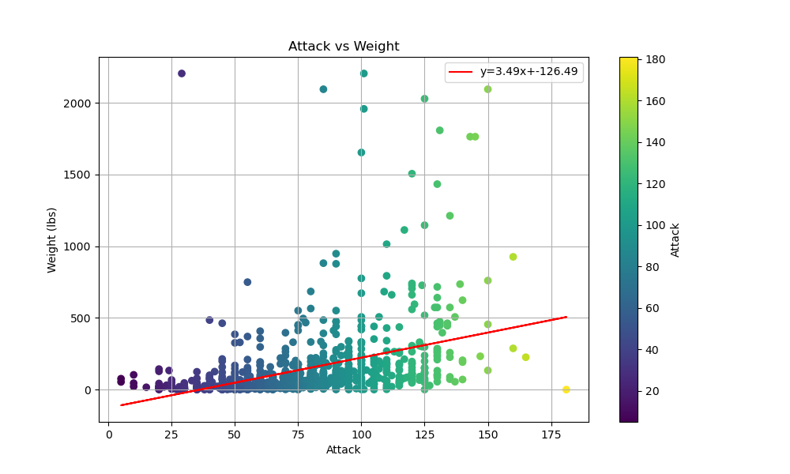
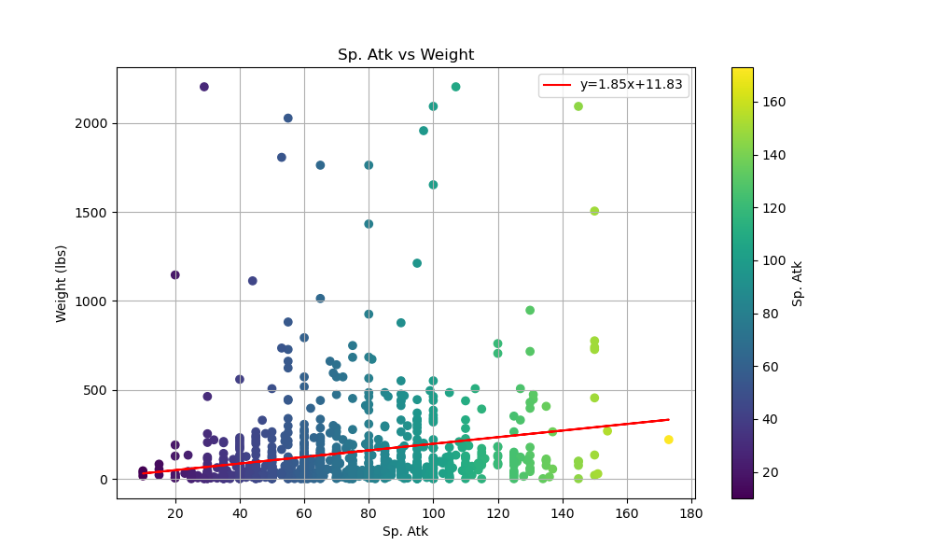

Size vs Stat: Offense
Only very weak positive correlations exist in the comparisons between Pokémon size and Pokémon stats, the strongest of which being Attack vs Weight with many random outliers splayed throughout the charts.
Project Alpha Six

Slide 11
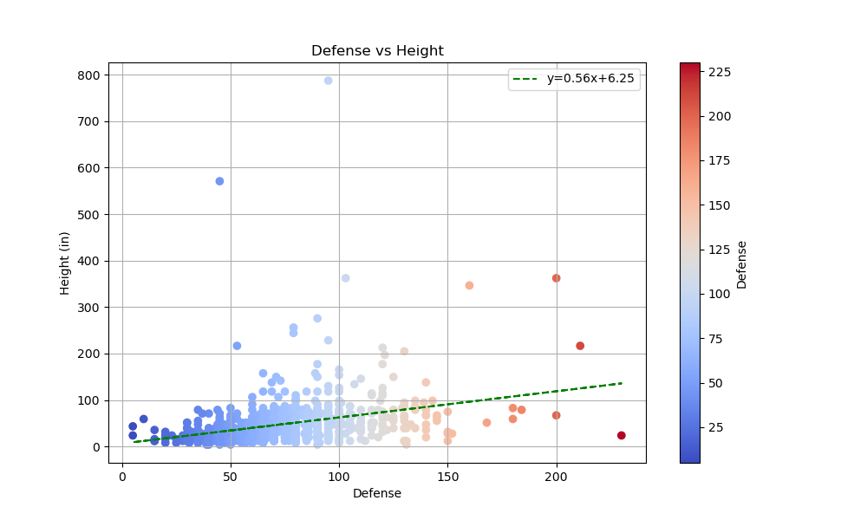
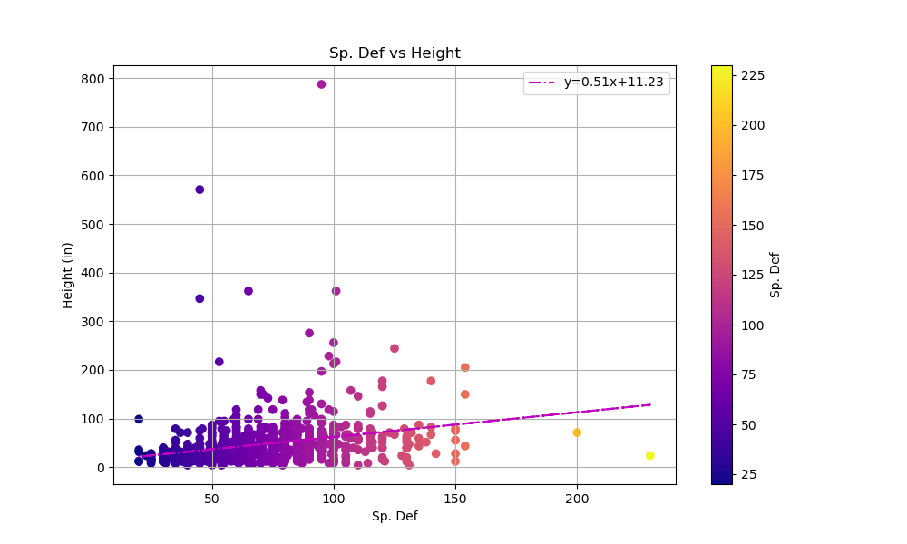
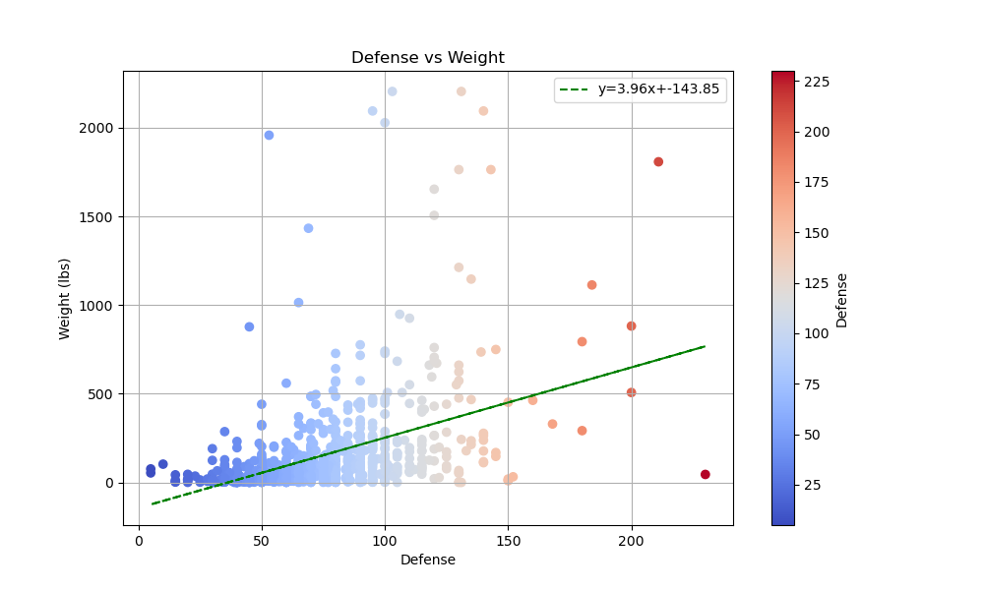
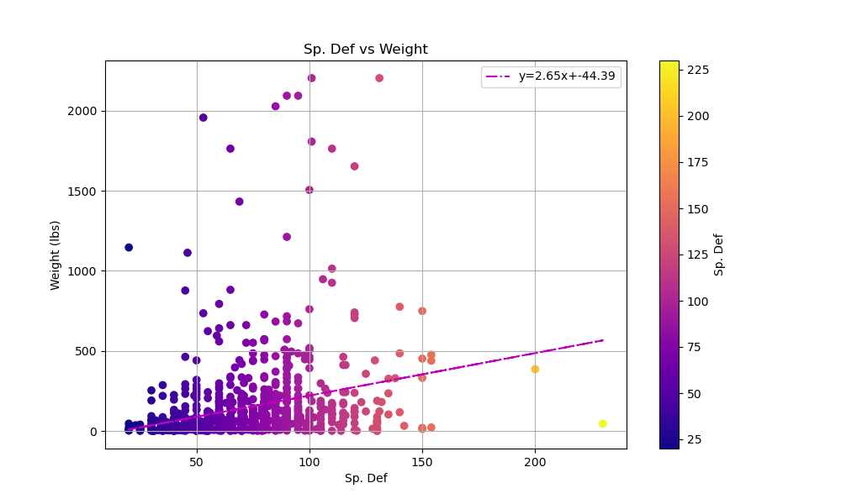

Size vs Stat: Defense
Much like the previous slide with offense stats and Pokémon size, there are only weak positive correlations in these comparisons, the strongest of which being Defense vs Weight, with many outliers splayed throughout the charts.
Project Alpha Six

Slide 12
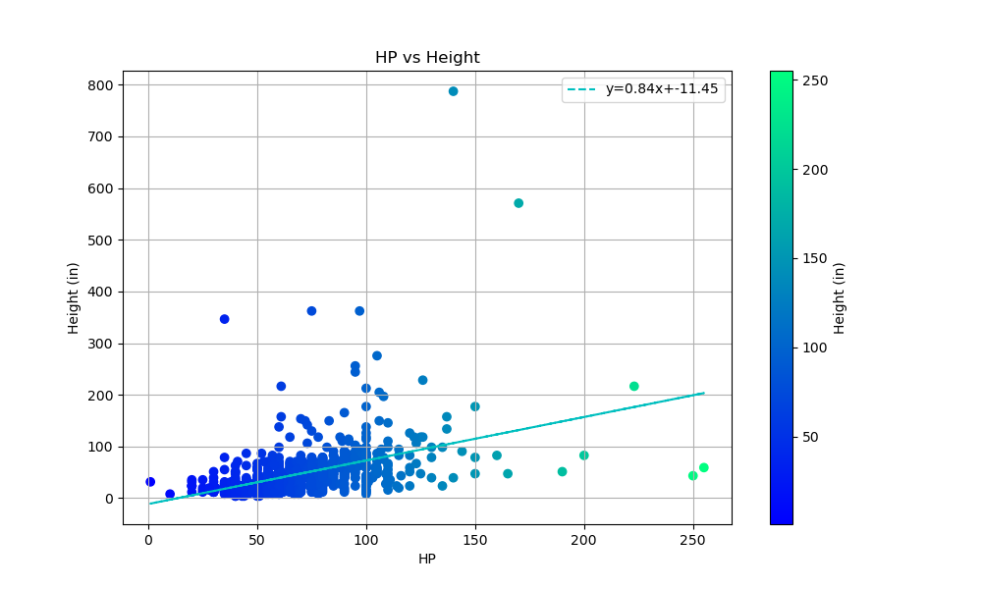
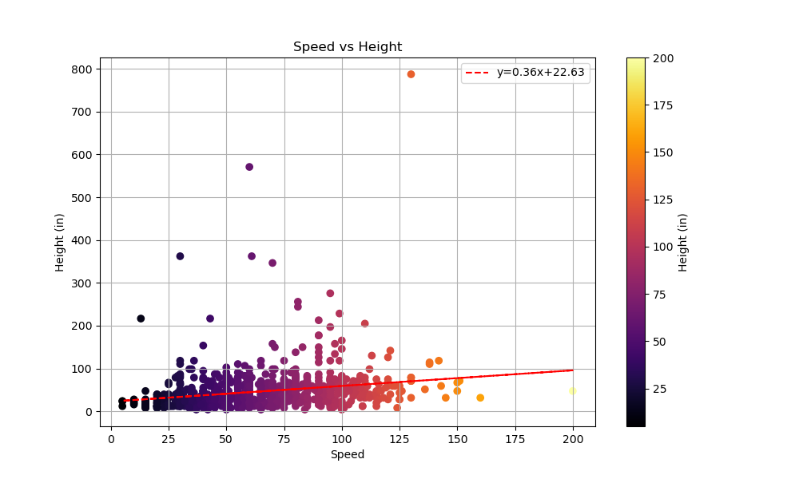
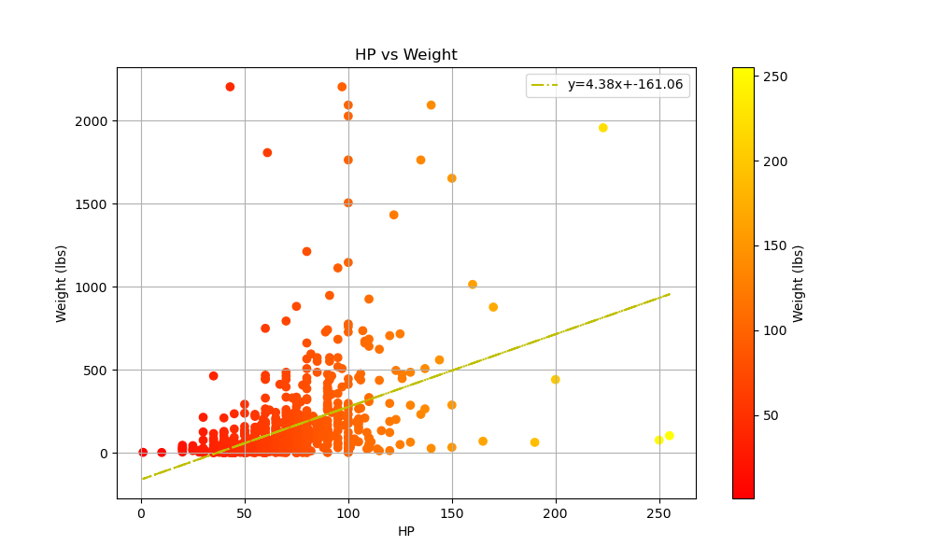
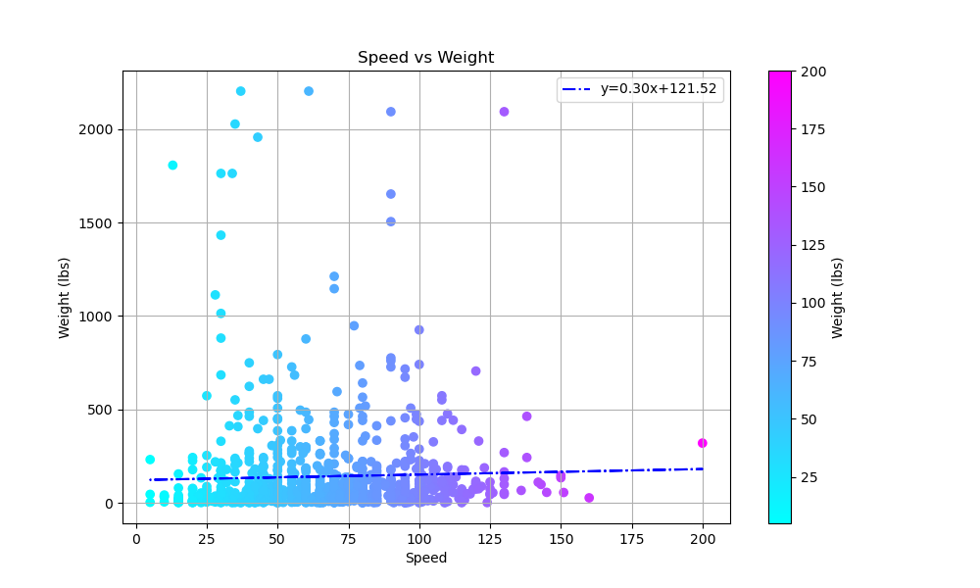

Size vs Stat: HP and Speed
Amongst all the size vs stat comparisons, HP vs Weight shows the strongest positive correlation, with Speed vs Weight displaying the weakest correlation of all.
Project Alpha Six

Slide 13
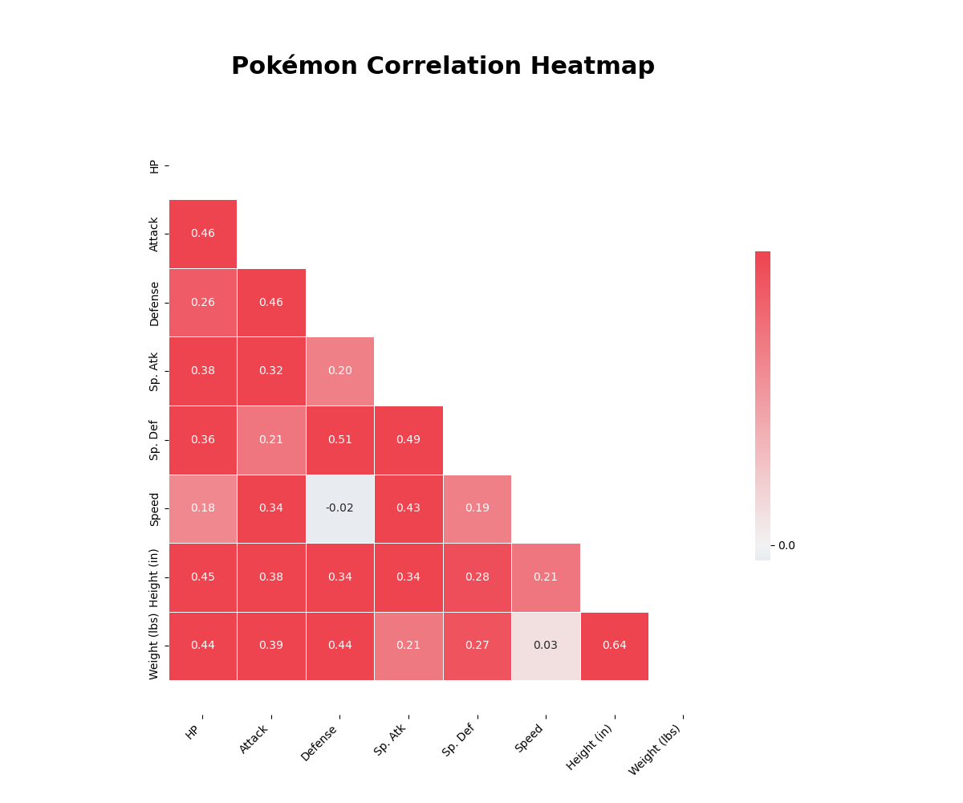

Size vs Stat Analysis
As it turns out, size doesn’t matter as much in building an effective championship team. A large portion of the competitive advantage lies more within the Pokémon's stats rather than its height or weight, which we’ve proven to have barely any relationship.
In the accompanying correlation heatmap, we can also see other relationships we didn’t dive into, especially the (albeit weak) negative correlation between Speed and Defense. Better yet, the strongest correlation in this heatmap is Height vs Weight, rather than any stats relationship we’ve seen thus far.
Project Alpha Six

Slide 14

The Pokémon Champion wants to fight! What’s the ideal team to defeat him?
Project Alpha Six

Slide 15

Team One – Single Stat
Name | 1st Type | 2nd Type | HP | Attack | Defense | Sp. Atk | Sp. Def | Speed
Blissey | Normal | --- | 255 | 10 | 10 | 75 | 135 | 55
Kartana | Grass | Steel | 59 | 181 | 131 | 59 | 31 | 109
Shuckle | Bug | Rock | 20 | 10 | 230 | 10 | 230 | 5
Xurkitree | Electric | --- | 83 | 89 | 71 | 173 | 71 | 83
Shuckle | Bug | Rock | 20 | 10 | 230 | 10 | 230 | 5
Ninjask | Bug | Flying | 61 | 90 | 45 | 50 | 50 | 160
Team Two – Size Based
Name | 1st Type | 2nd Type | HP | Attack | Defense | Sp. Atk | Sp. Def | Speed | Height (in) | Weight (lbs)
Comfey | Fairy | --- | 51 | 52 | 90 | 82 | 110 | 100 | 3.94 | 0.66
Cutiefly | Bug | Fairy | 40 | 45 | 40 | 55 | 40 | 84 | 3.94 | 0.44
Wailord | Water | --- | 170 | 90 | 45 | 90 | 45 | 60 | 570.87 | 877.44
Kartana | Grass | Steel | 59 | 181 | 131 | 59 | 31 | 109 | 11.81 | 0.22
Haunter | Ghost | Poison | 45 | 50 | 45 | 115 | 55 | 95 | 62.99 | 0.22
Celesteela | Steel | Flying | 97 | 101 | 103 | 107 | 101 | 61 | 362.20 | 2204.40
Project Alpha Six

Slide 16

Team Three – Total Stats Team
Name | 1st Type | 2nd Type | HP | Attack | Defense | Sp. Atk | Sp. Def | Speed | Total Stats
Slaking | Normal | --- | 150 | 160 | 100 | 95 | 65 | 100 | 670
Tyranitar | Rock | Dark | 100 | 134 | 110 | 95 | 100 | 61 | 600
Kommo-o | Dragon | Fighting | 75 | 110 | 125 | 100 | 105 | 85 | 600
Salamence | Dragon | Flying | 95 | 135 | 80 | 110 | 80 | 100 | 600
Metagross | Steel | Psychic | 80 | 135 | 130 | 95 | 90 | 70 | 600
Garchomp | Dragon | Ground | 108 | 130 | 95 | 80 | 85 | 102 | 600
Project Alpha Six

Slide 17

Points of Recap:
Most Common Types: Water Normal Grass
Rarest Types: Ice Ghost Steel Fairy
The Fighting type has the highest average attack stats, even though Kartana, a Grass/Steel type, boasts the top attack stat.
The Psychic type holds the title for highest average Sp. Atk and Sp. Def stats, even though the top Sp. Atk belongs to an Electric type and the top Sp. Def belongs to a Bug/Rock Pokémon.
The Steel type has the highest average defense, but a Bug/Rock Pokémon boasts the highest actual defense stat.
Electric type Pokémon have the highest average speed, but the highest speed stat belongs to a Bug/Flying Pokémon.
The Dragon type leads in average HP, while the highest HP stat belongs to a Normal type Pokémon.
Among the team of six Pokémon with the highest total stats, Dragon is the most common type.
Slaking, a Normal type, has the highest total stats at 670, but its ability, Truant, forces it to skip every other turn, reducing its effectiveness.
Kartana, one of the lightest Pokémon, holds the highest Attack stat.
The most effective team could be assembled from the '600 Base Stat Club' which includes Dragonite, Tyranitar, Salamence, Metagross, Garchomp, Hydreigon, Goodra, Kommo-o, and Dragapult.
Project Alpha Six

Slide 18
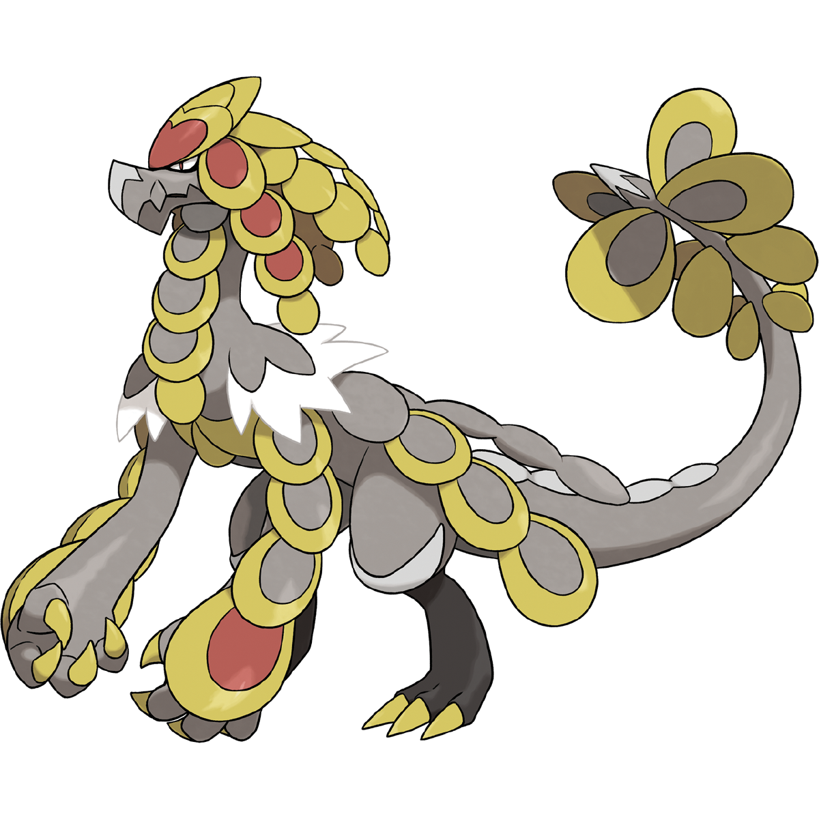

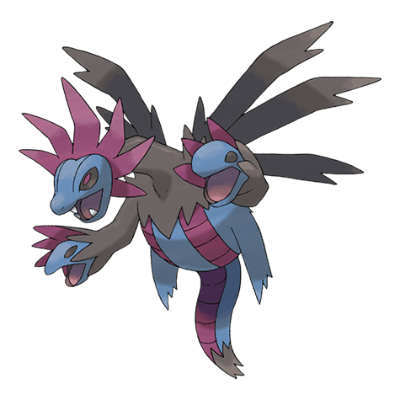



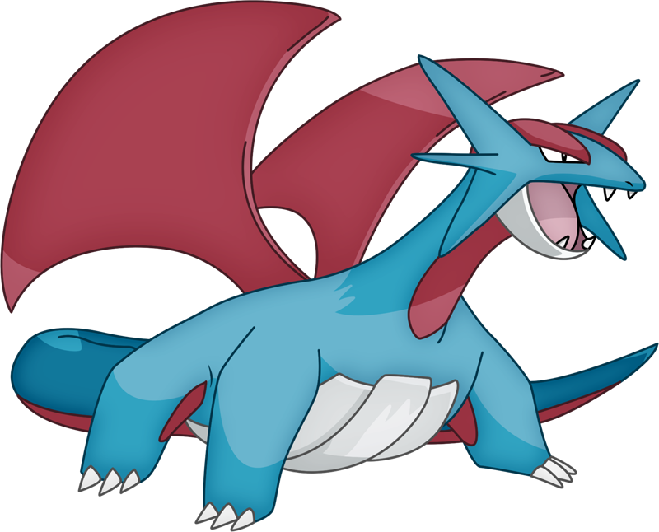
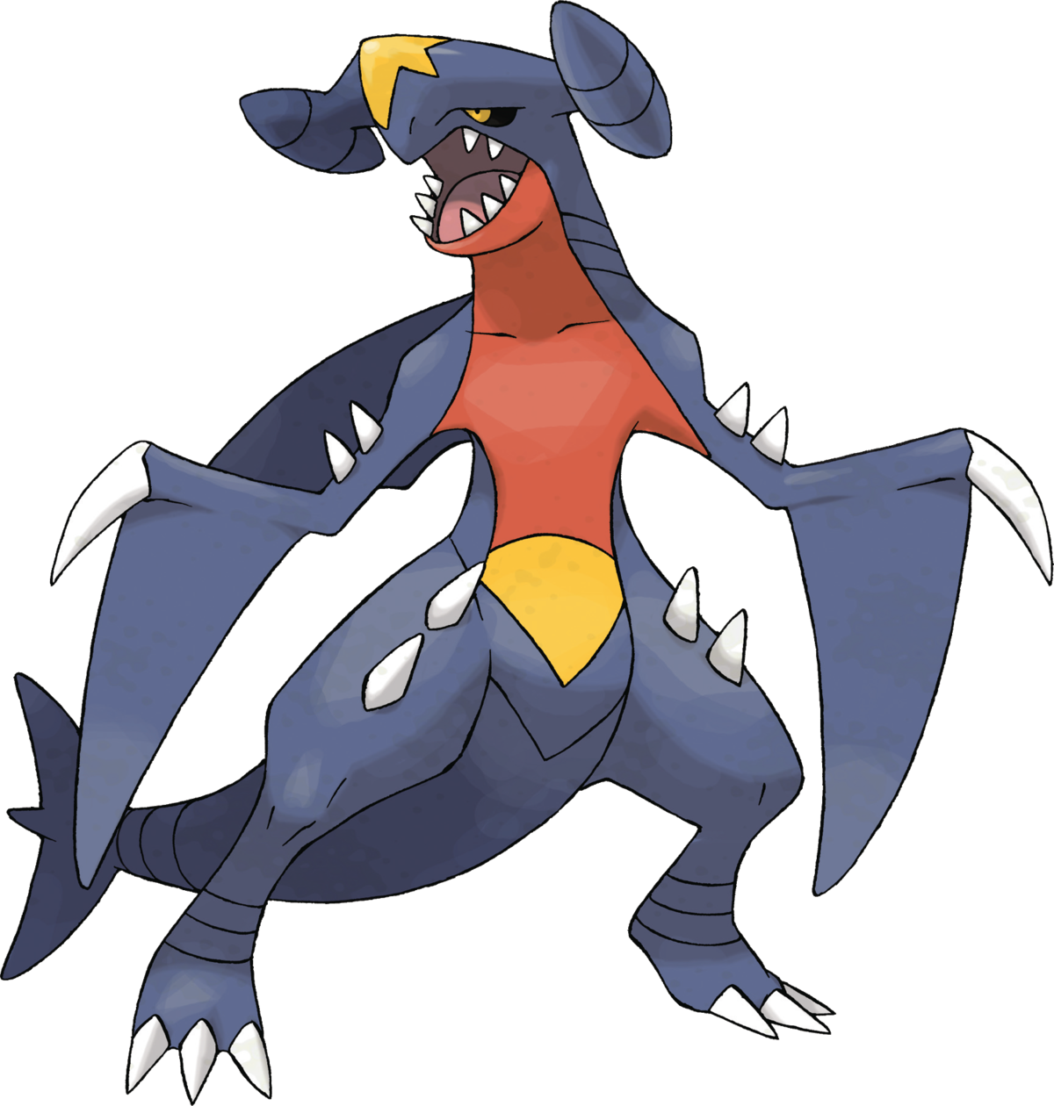

The Elite 600 Club
Any combination of these elites can help build the right time for the Pokémon League. Seven out of these nine Pokémon are Dragon type with their 600 base stat points distributed in ways that grant them overall strength and power. Most of these Pokémon have also been used by former Champions!
Project Alpha Six
This Photo by Unknown Author is licensed under CC BY-SA-NC

Slide 19






Can you and your favorite Pokémon become World Champions?
Project Alpha Six
This Photo by Unknown Author is licensed under CC BY-SA

Slide 20
Credits:
Pokémon Champion Selfie - https://twitter.com/goro_orb/status/1496901044550639619?s=20
Type Sprite Images - https://www.spriters-resource.com/fullview/123715/
Pokémon Types - https://www.pngitem.com/middle/hThhTTJ_all-pokemon-types-hd-png-download/
Poke ball Collection - https://www.pngitem.com/middle/hwwwhTx_pokeball-sprites-hd-png-download/
Pokémon Chibi Stickers by Miaow - https://www.deviantart.com/miaow/gallery
Pokémon Chibi Stickers Shop - https://www.etsy.com/shop/CommanderMittensCo?section_id=33458665
Pokémon Championships Banner - https://www.pokemon.com/us/play-pokemon/internationals/2022/north-america/about/
A hell of a lot of Wiki pages for extra sprites and images
PokeAPI for all the data necessary to even do this
Monster Energy for keeping me up to work on this
And last, but not least, Miggy and Mabeyda for their efforts in this project.
Project Alpha Six

